Slide 1
Application of machine learning tools for the analysis and prediction of wind and solar power generation
Tarek Ahmed 200108144
Md. Sabbir Hossain 200108148

Slide 2
Content
Research Goal
Introduction
Objective
The Process of
Development
Methodology
Literature review and Research Gap
Model Development
Result
And
Discussion
References

Slide 3
Research Goal
Develop a Machine Learning Model for Wind and Solar Power Generation Prediction
Implement Time Horizon Forecasting for Wind and Solar Power Generation
Integration and Optimization

Slide 4

Introduction
This study applies machine learning to forecast wind and solar power generation using meteorological and historical data. It aims to improve prediction accuracy, enhance grid stability, and optimize resource allocation. The work supports the transition to sustainable energy systems.

Slide 5
Objectives
ML algorithms predict renewable energy from meteorological data.
Forecast renewable energy at various time horizons.
Enhance grid stability, efficiency, cost savings with accurate renewable energy forecasts.

Slide 6
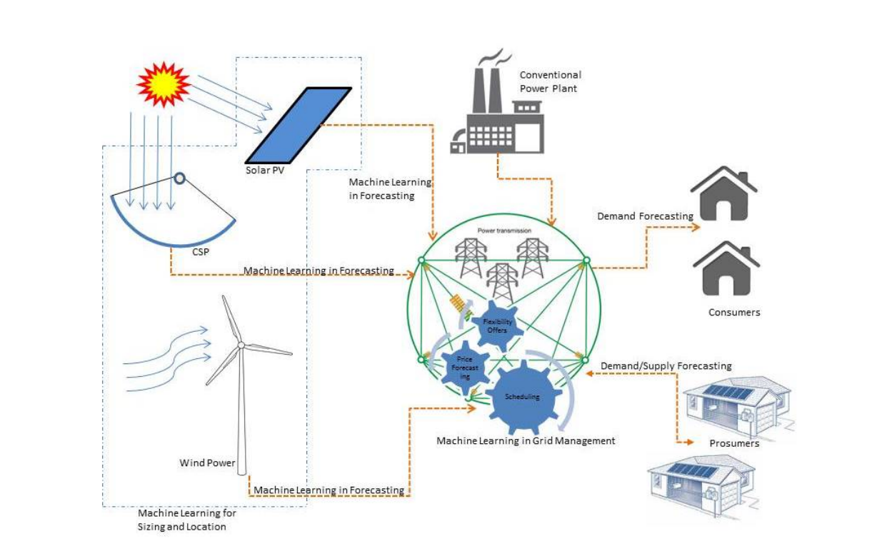
Literature Review
Review on "Machine Learning Techniques for Supporting Renewable Energy Generation and Integration: A Survey" (Paper 1)
Survey explores machine learning's role in predicting, optimizing, and integrating renewable energy sources for sustainable grid management.
Courtesy : https://scihub.se/https://doi.org/10.1016/j.triboint.2016.12.035

Slide 7
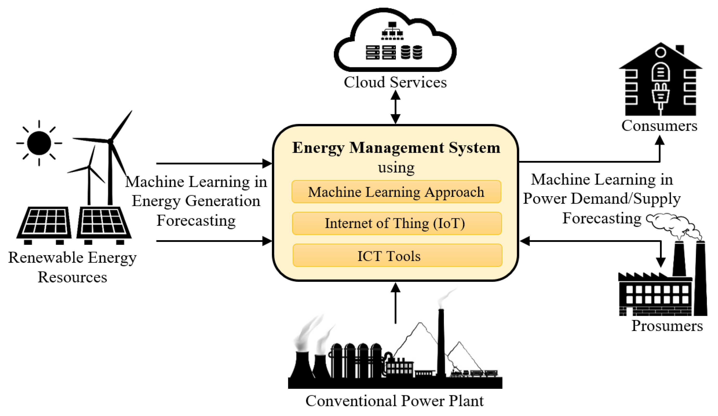
Literature Review
Review on "Machine-learning methods for integrated renewable power generation: A comparative study of artificial neural networks, support vector regression, and Gaussian Process Regression" (Paper 2)
Research investigates machine learning models (ANN, SVR, GPR) to enhance predictability of renewable energy (wind, solar) and demand, reducing reliance on costly storage and standby capacity in electricity grid.
Courtesy : https://scihub.se/https://doi.org/10.1016/j.triboint.2016.12.035,

Slide 8
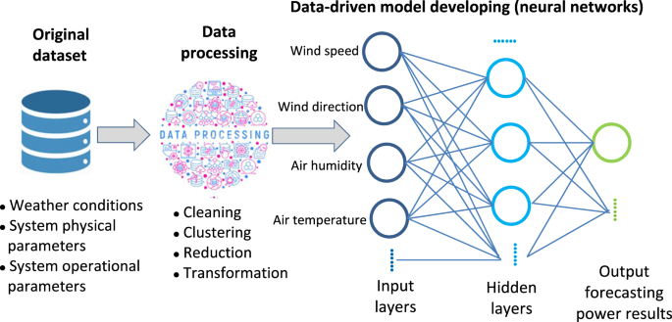
Literature Review
Review on "Predicting Solar Generation from Weather Forecasts Using Machine Learning" (Paper 3)
Paper explores machine learning for site-specific solar power prediction using National Weather Service data, achieving 27% accuracy improvement.
Courtesy : https://scihub.se/https://doi.org/10.1016/j.triboint.2016.12.035,

Slide 9
Research Gap
Integration of Advanced Forecasting Techniques
Enhancing Forecasting for Dynamic Grid Stability
Optimization of Data Utilization in Renewable Forecasting

Slide 10
Methodology
Step 1
The statement of the problem
Step 2
The determination of objectives
Step 3
The process of reviewing the literature
Step 4
The formulation of methodology
Step 5
The process of Development
Step 6
The Reporting

Slide 11
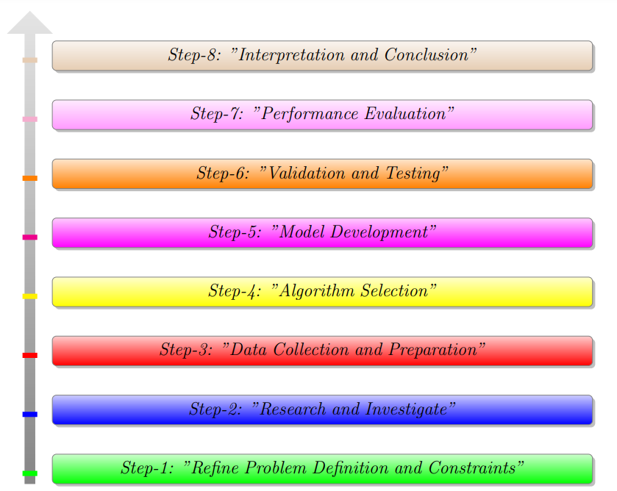
The Process of Development
Figure : Methodology of the thesis Project

Slide 12
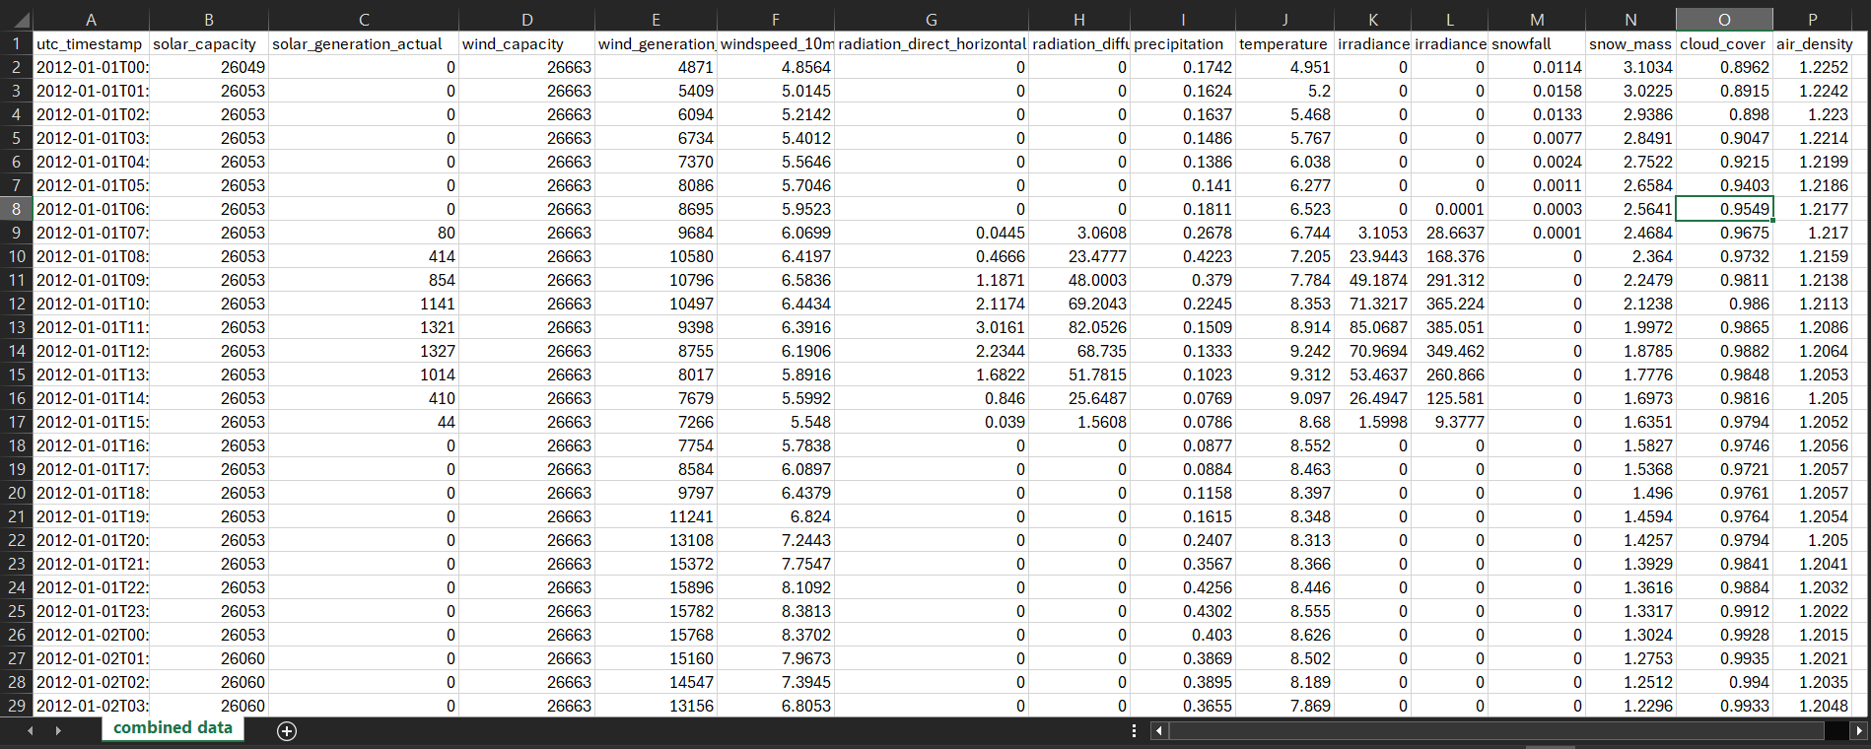
Data Collection and Preparation
Wind and solar power production data sourced from time-series records, paired with hourly weather data from Renewables.ninja using NASA MERRA-2.
Figure : Raw Data from NASA MERRA-2

Slide 13
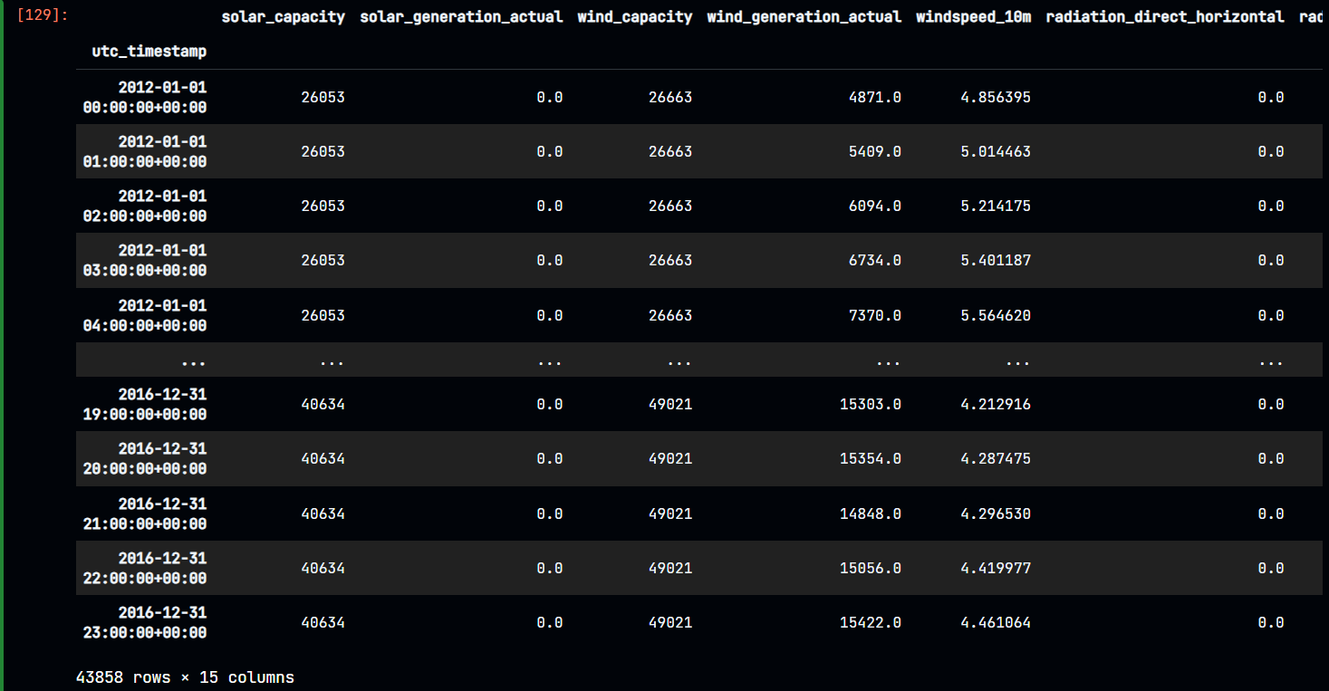
Data Cleaning Process
Here is the Final output of Data cleaning process where 43858 rows × 15 columns are present and no missing value.
Figure : Cleaned data without missing values

Slide 14
Algorithms
Linear Regression model
Decision Tree Regression model
Random Forest Regression model

Slide 15
Modeling
Model training
Cross-validation
Model testing
Model tuning

Slide 16
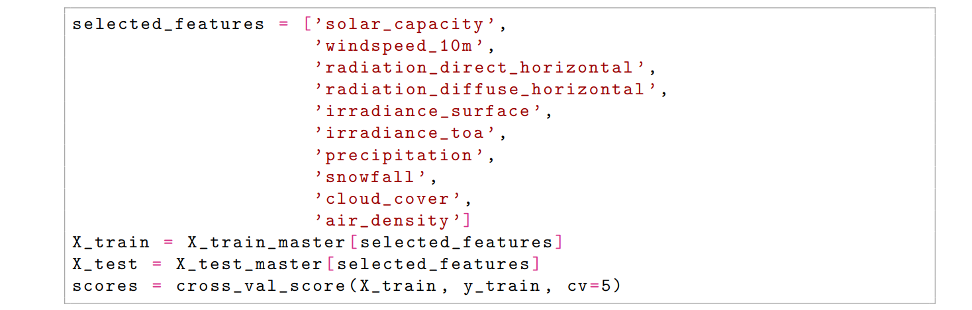
Solar Power Features

Slide 17
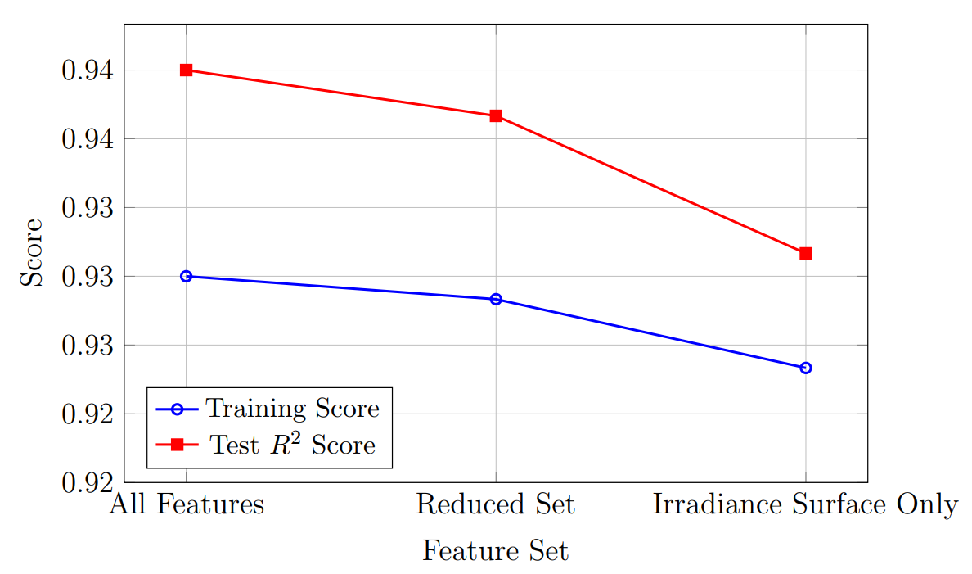
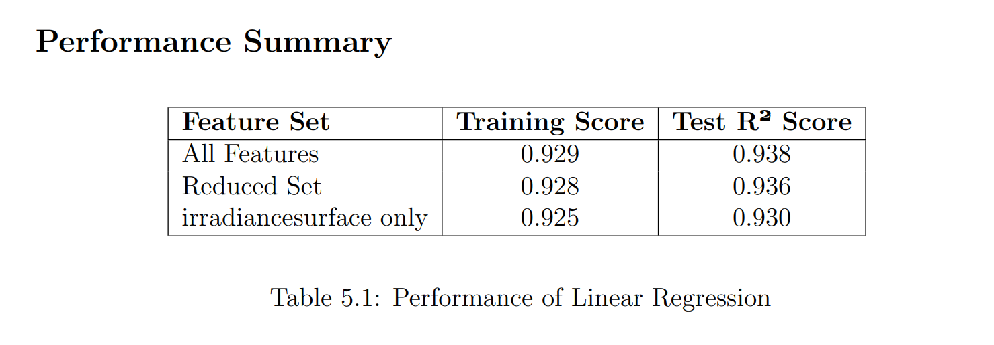
Linear Regression

Slide 18
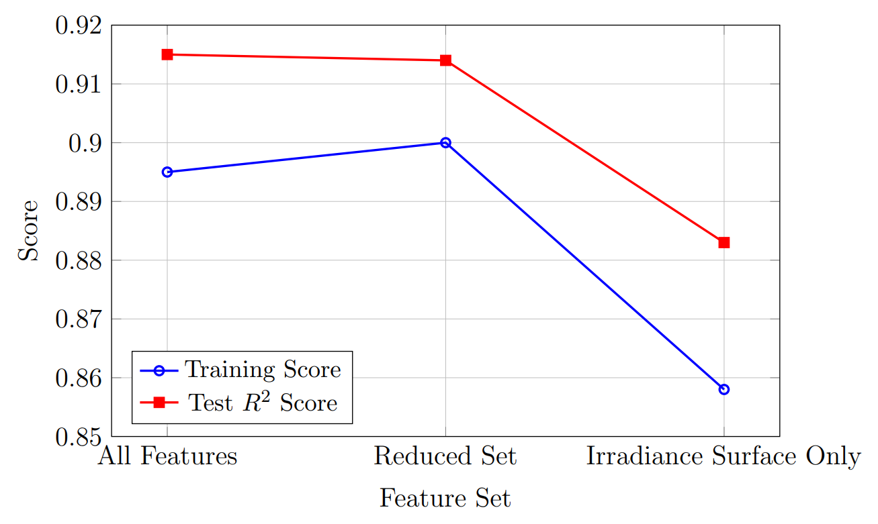
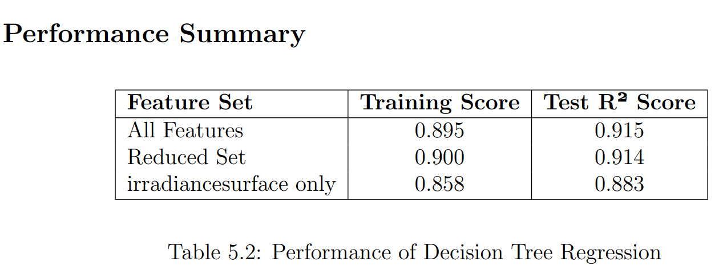
Decision Tree Regression

Slide 19
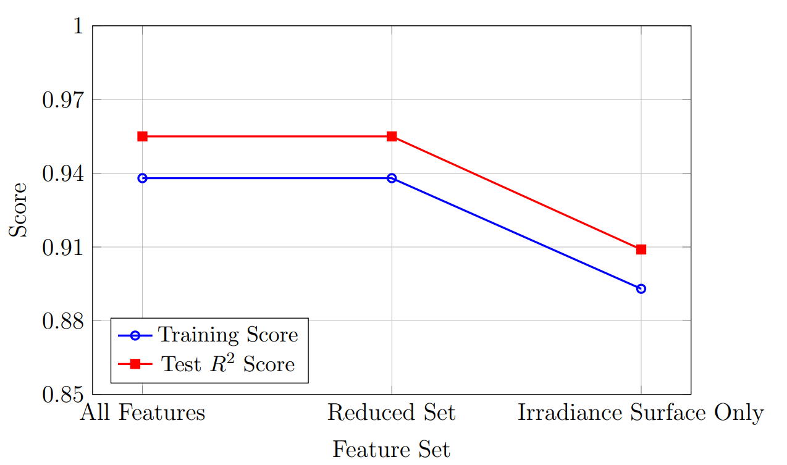
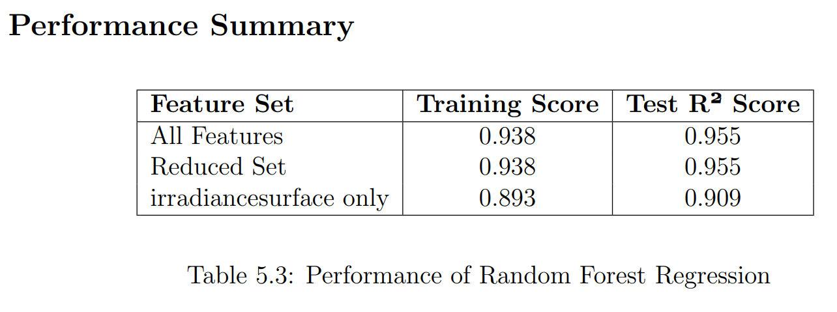
Random Forest Regression

Slide 20
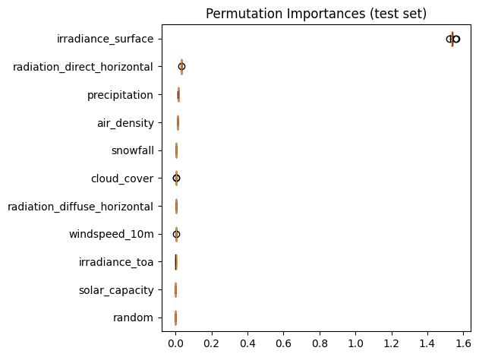
Best Feature for Solar Model

Slide 21
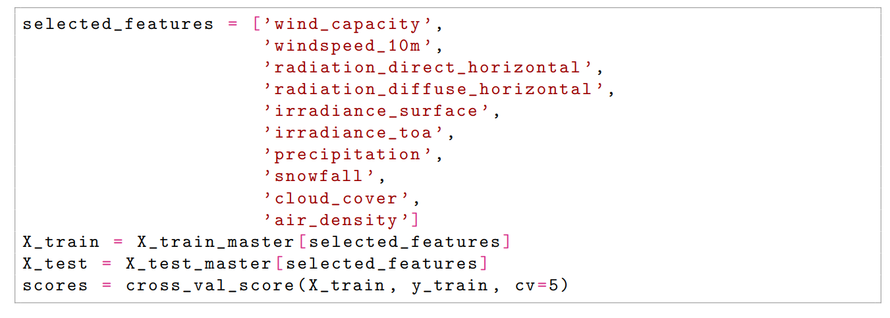
Wind Power Features

Slide 22
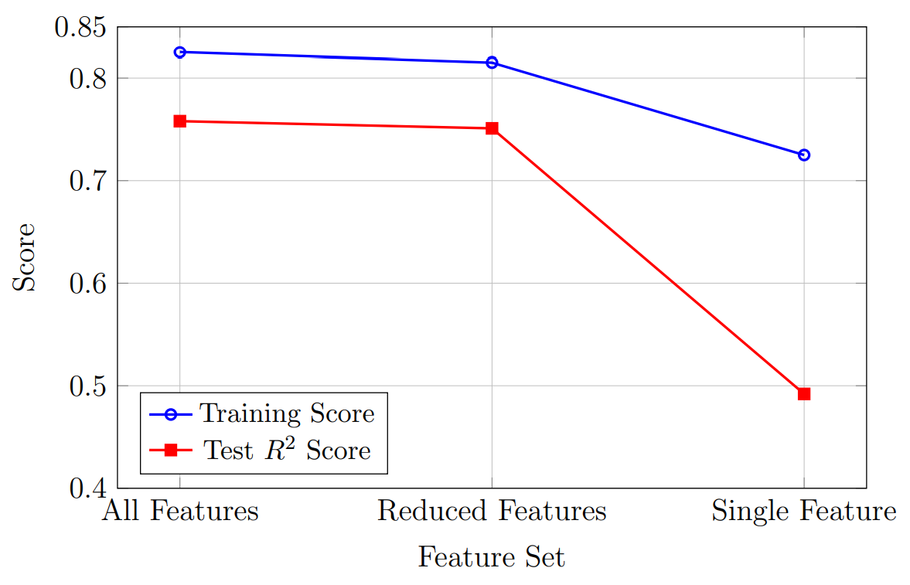
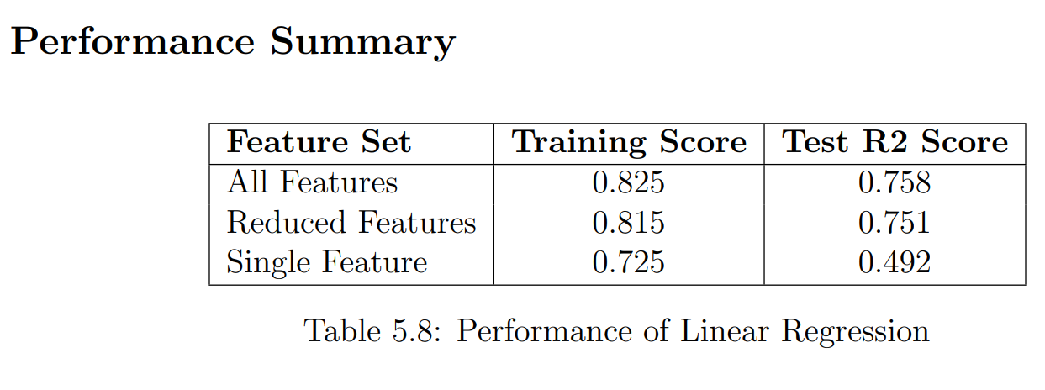
Linear Regression

Slide 23
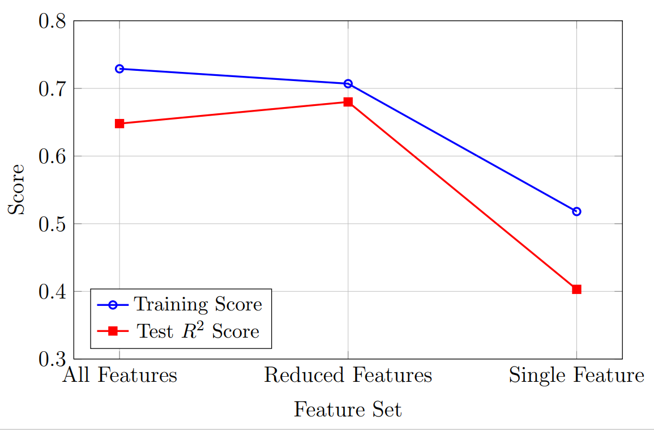
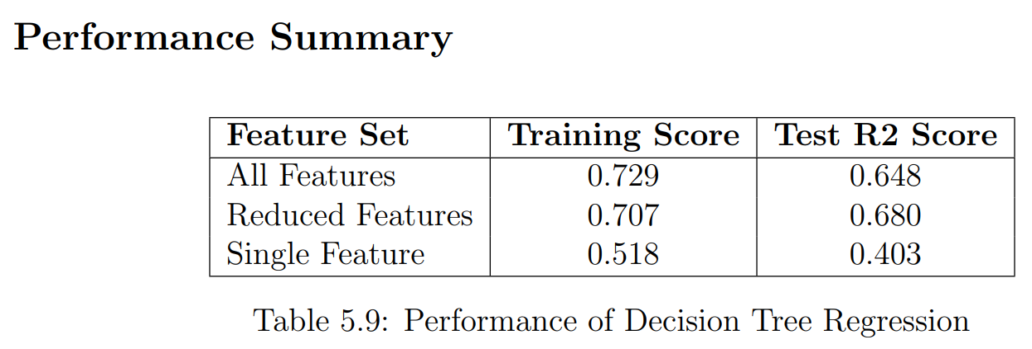
Decision Tree Regression

Slide 24
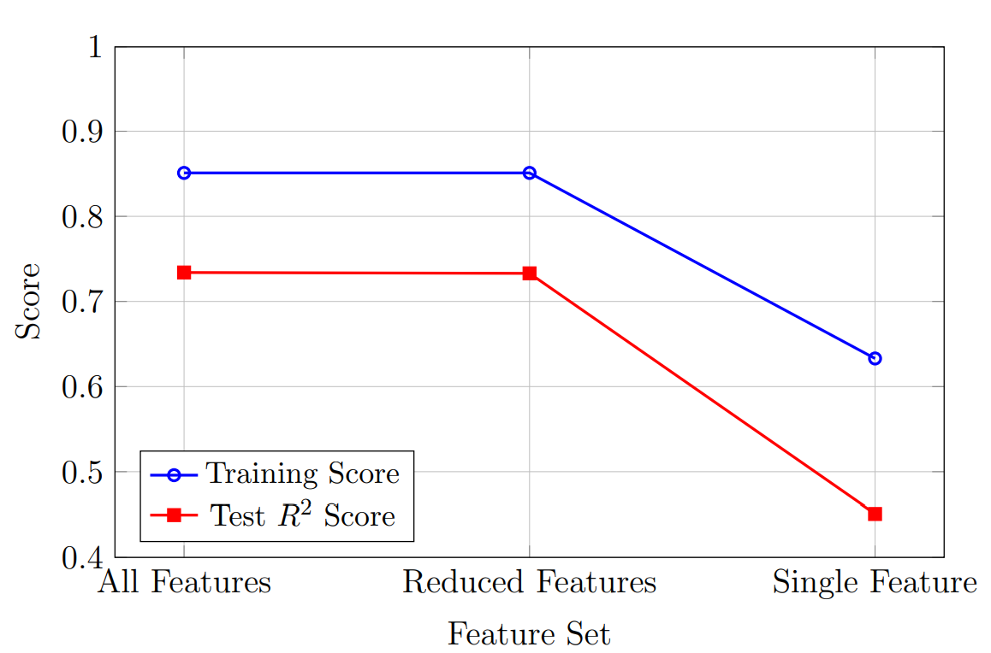
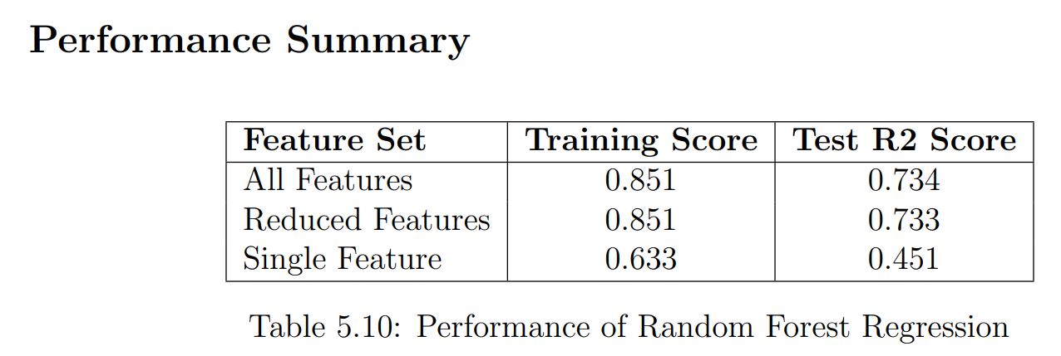
Random Forest Regression

Slide 25
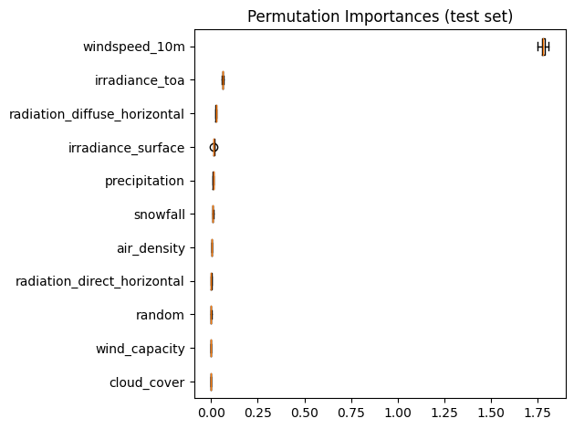
Best Feature for Wind Model

Slide 26
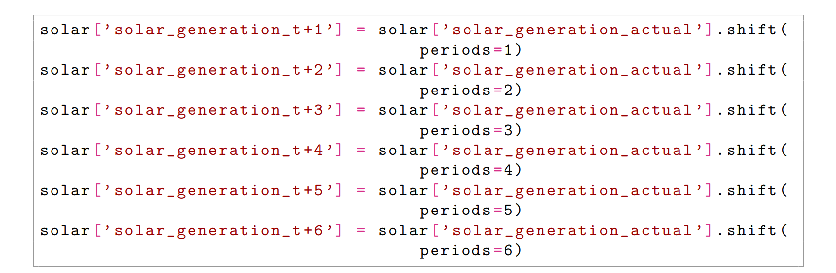
Solar Forecasting Features

Slide 27
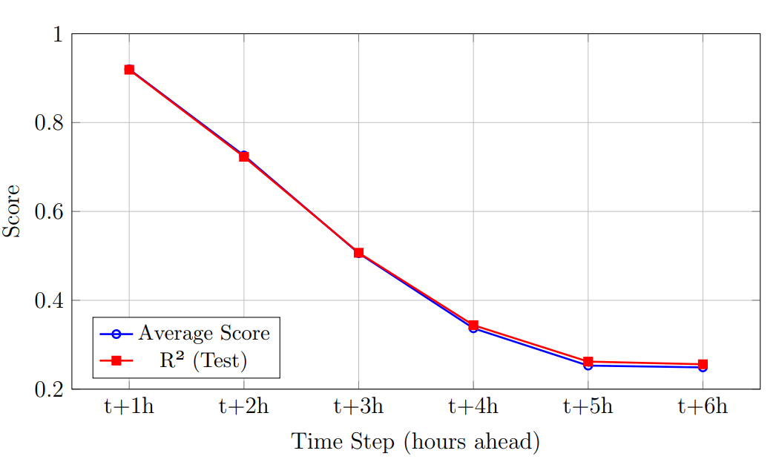
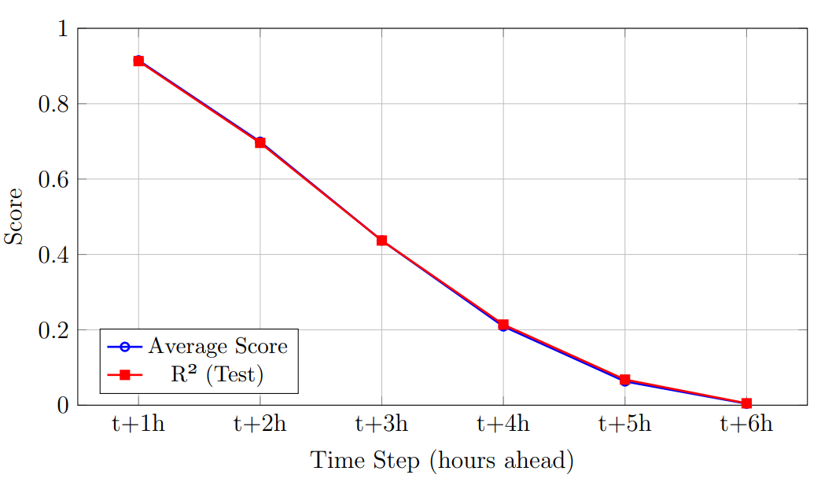
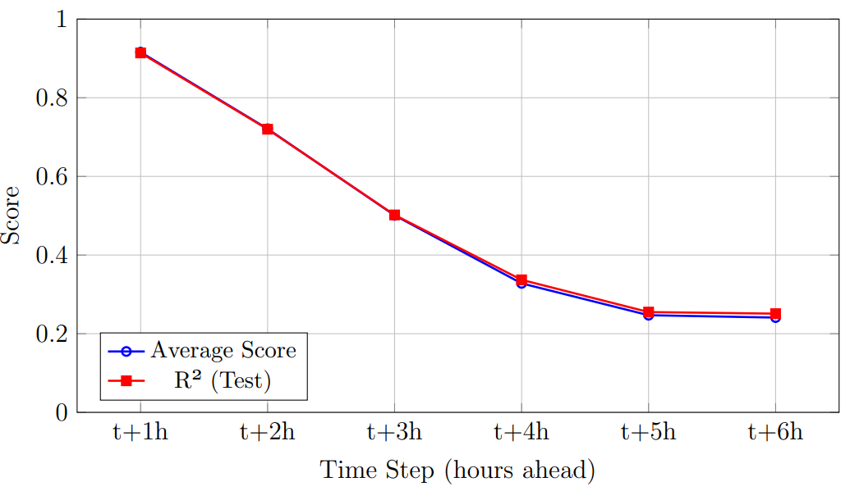
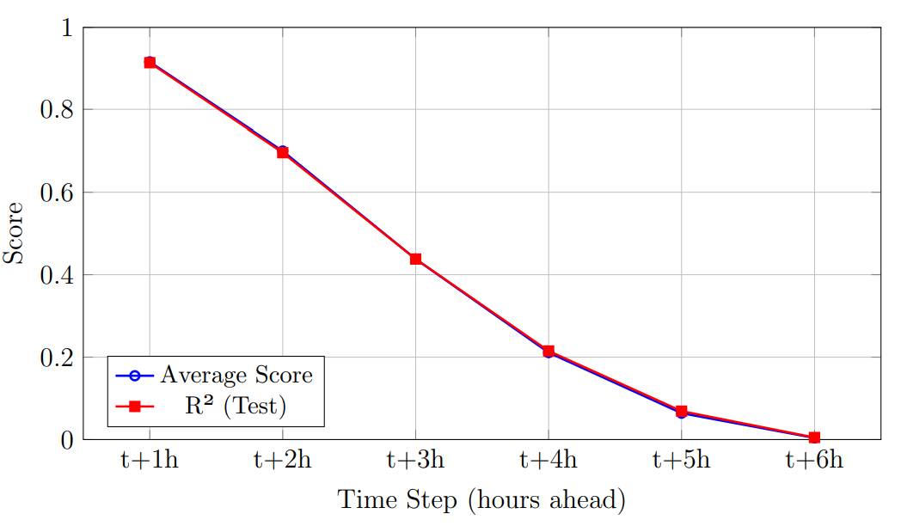
Linear Regression Forecasting
N = 11
N = 2
N = 8
N = 1

Slide 28
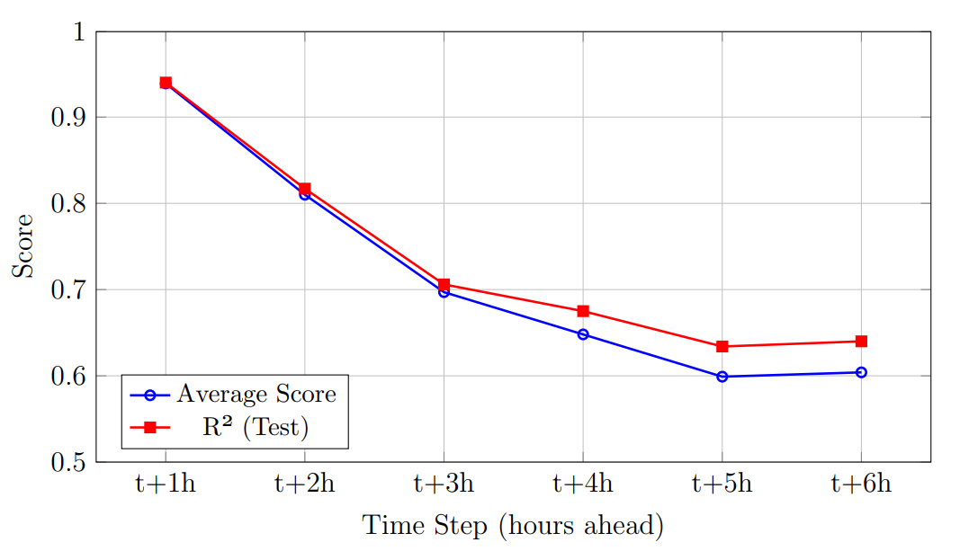
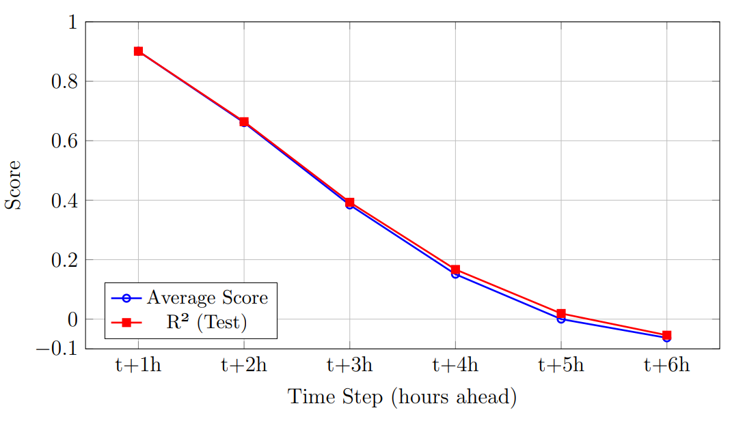
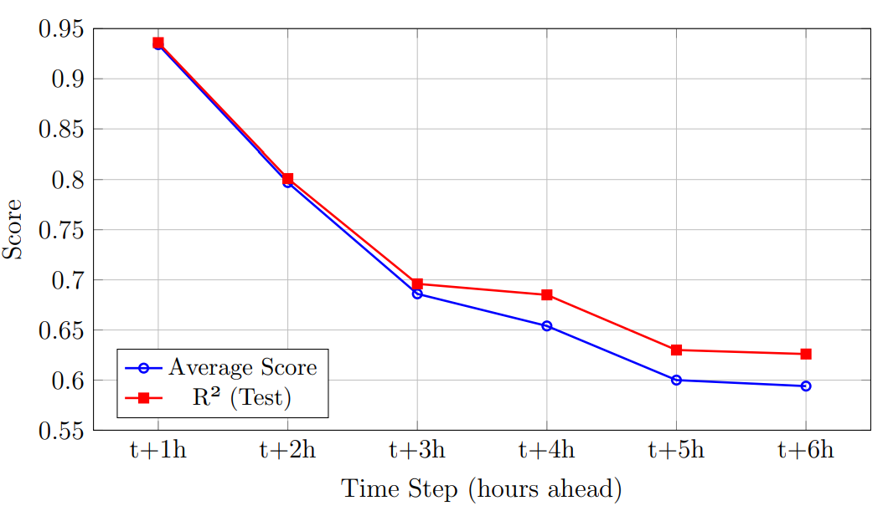
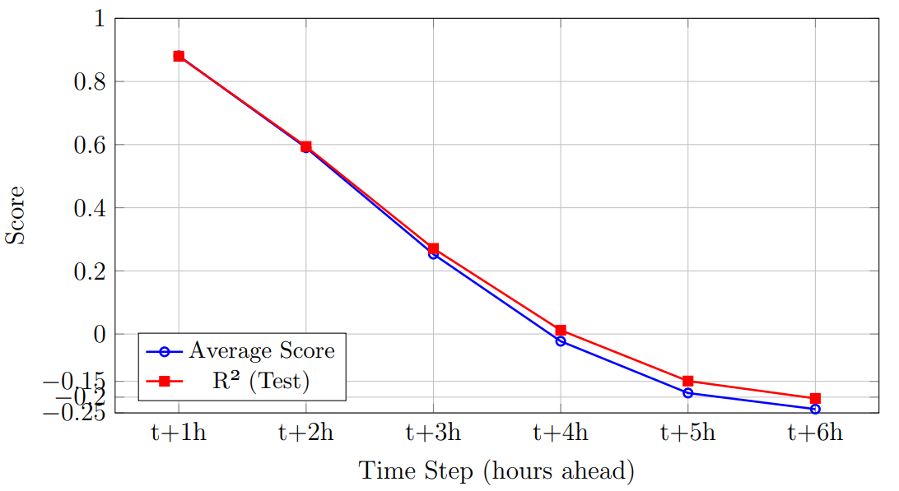
Random Forest Forecasting
N = 11
N = 2
N = 8
N = 1

Slide 29
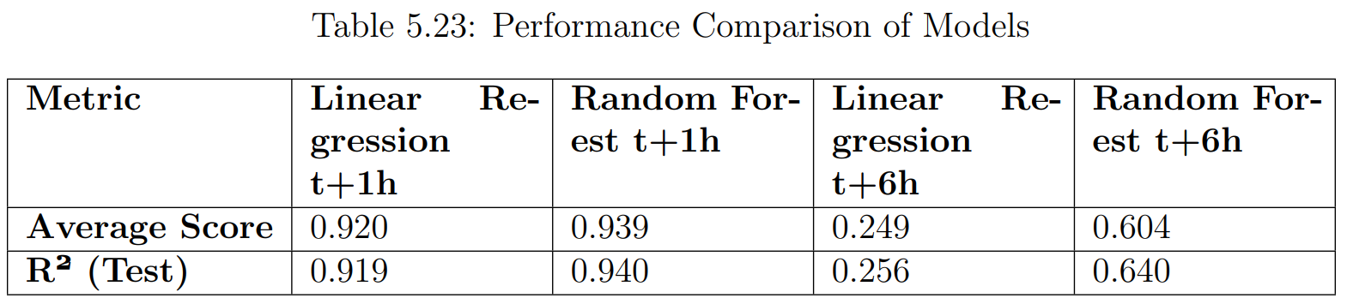
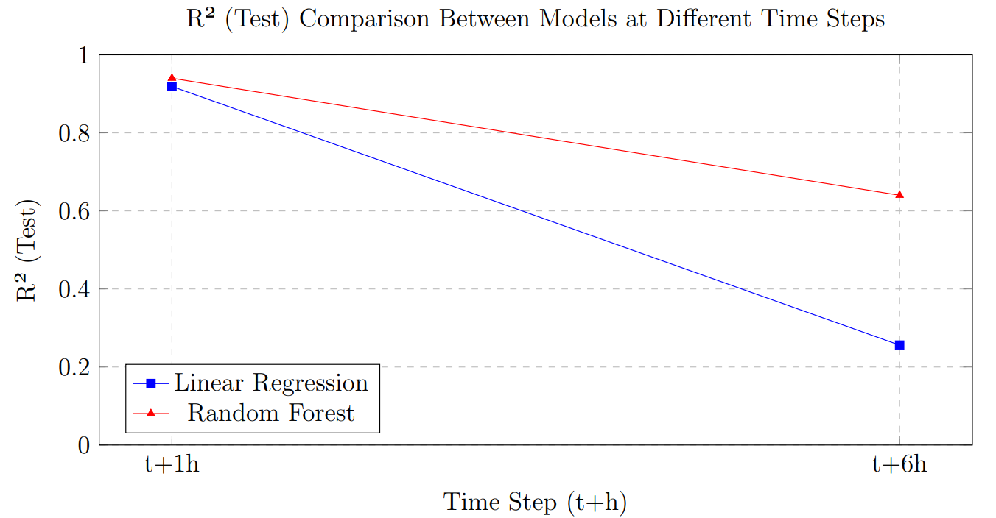
Performance Comparison
For short-term predictions, Random Forest clearly outperforms Linear Regression with higher accuracy. For long-term predictions, Random Forest performs significantly better and maintains more reliable results over time.

Slide 30
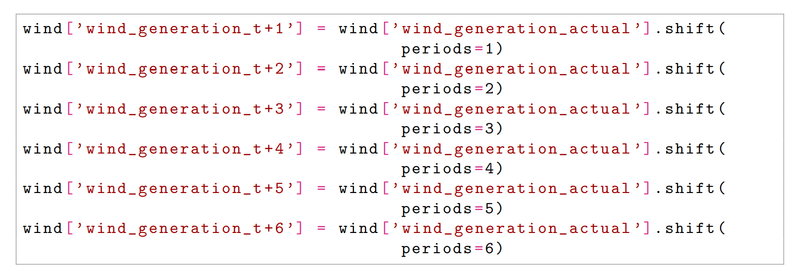
Wind Forecasting Features

Slide 31
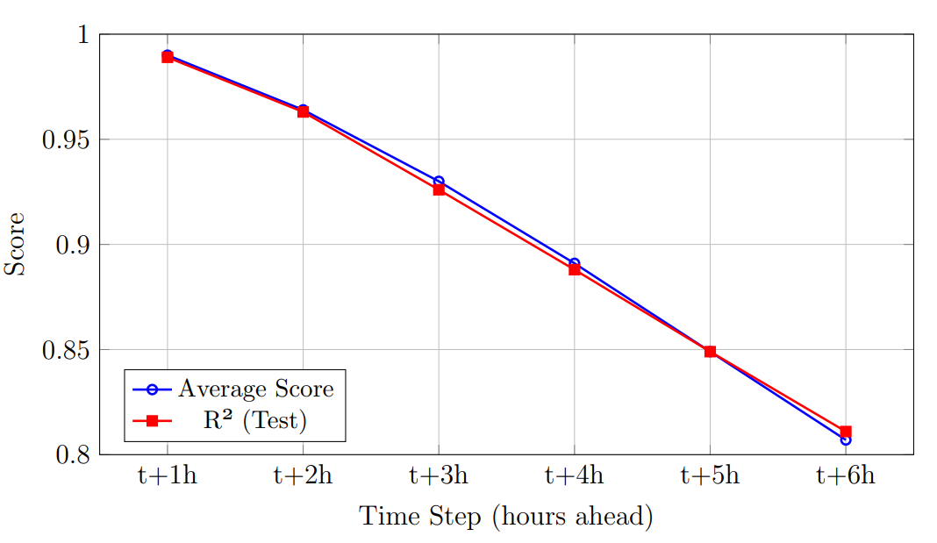
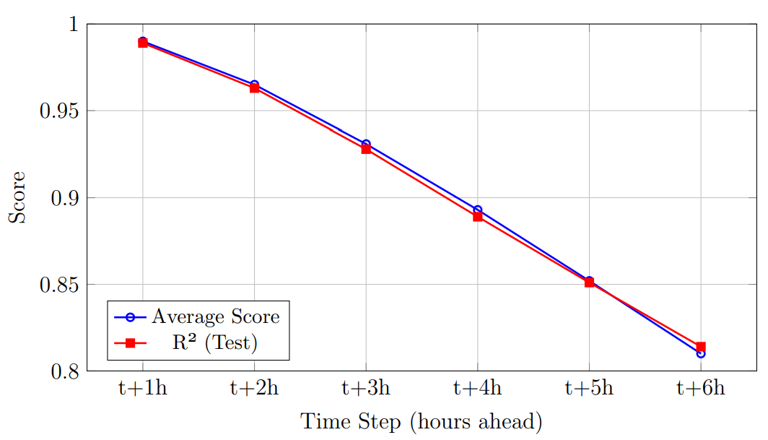
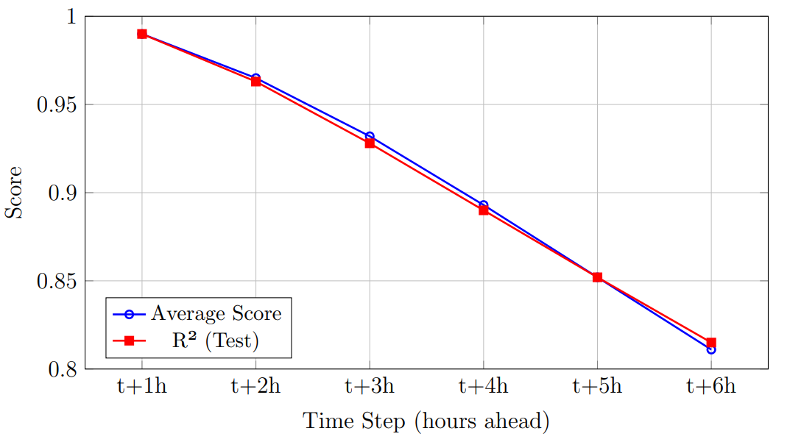
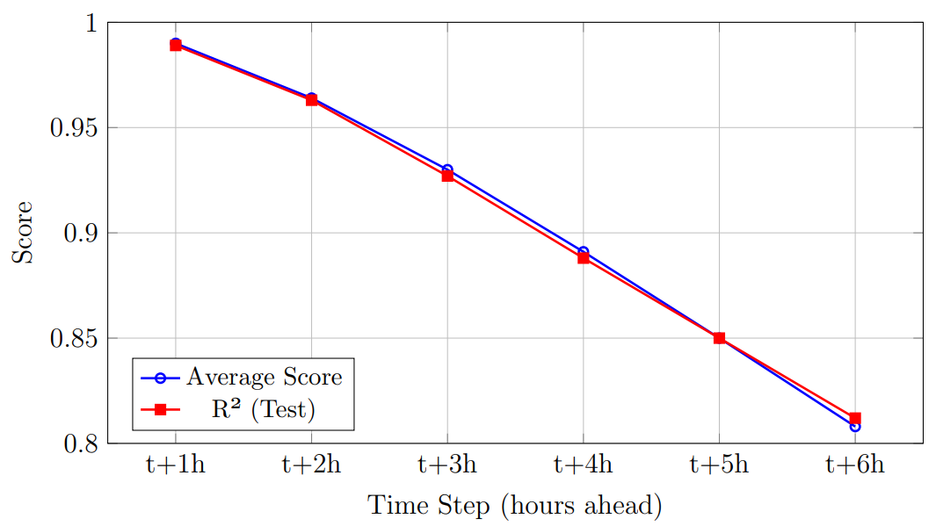
Linear Regression Forecasting
N = 11
N = 2
N = 8
N = 1

Slide 32
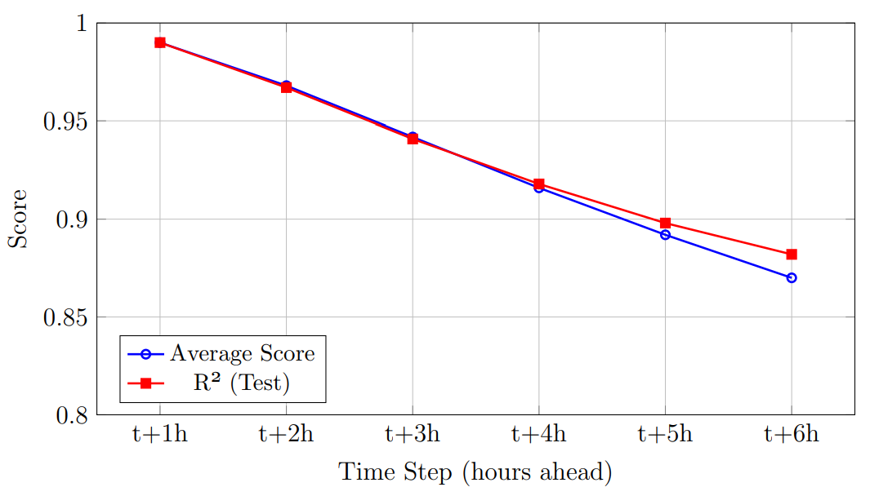
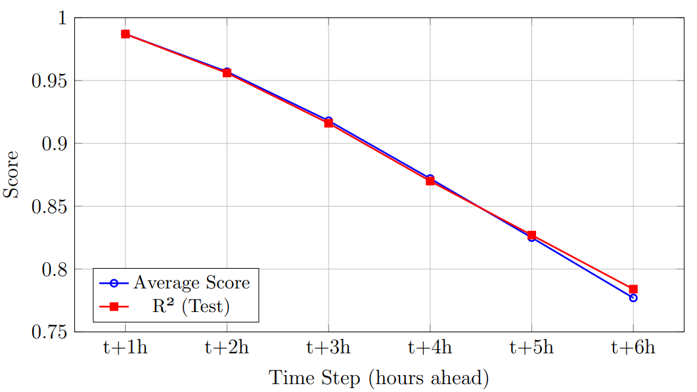
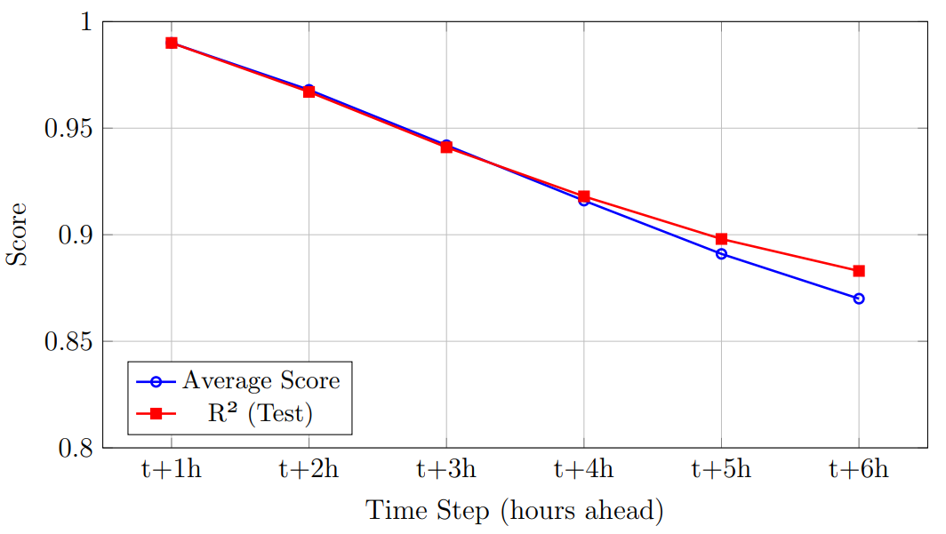
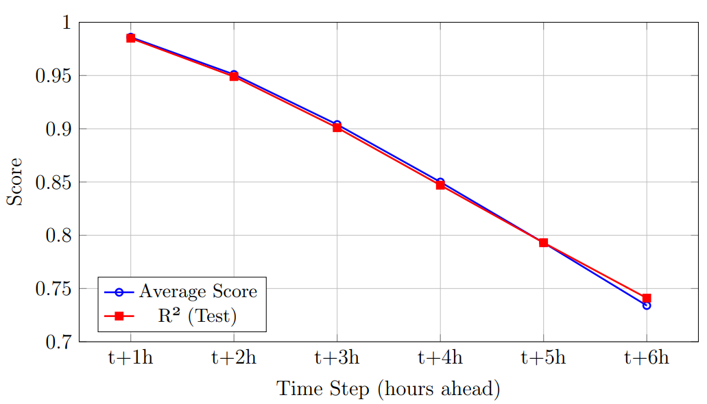
Random Forest Forecasting
N = 11
N = 2
N = 8
N = 1

Slide 33
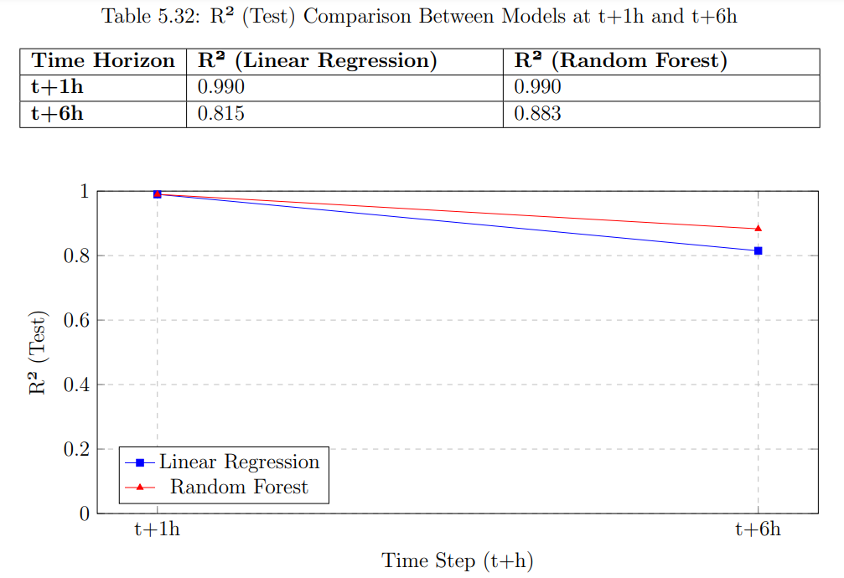
Performance Comparison
Random Forest demonstrates better long-term performance and is more suitable for predictions over extended time horizons

Slide 34
Conclusion
Improved Forecasting Accuracy
Enhanced Grid Stability and Resource Allocation
Significance of Data Preprocessing
Future Research Opportunities
Contribution to Sustainable Energy Transition

Slide 35
Future Recommendations
Explore Hybrid Models (e.g., Random Forest with LSTM or Gradient Boosting)
Incorporate Additional Meteorological Variables
Enhance Model Scalability
Focus on Real-Time Forecasting

Slide 36
Reference
[1] K. S. Perera, Z. Aung, and W. L. Woon, “Machine learning techniques for supporting renewable energy generation and integration: A survey,” in Data Analytics for Renewable Energy Integration: Second ECML PKDD Workshop, DARE 2014, Nancy, France, September 19, 2014, Revised Selected Papers 2, 2014, pp. 81–96.
[2] M. Sharifzadeh, A. Sikinioti-Lock, and N. Shah, “Machine-learning methods for integrated renewable power generation: A comparative study of artificial neural networks, support vector regression, and gaussian process regression,” in Renewable and Sustainable Energy Reviews, vol. 108, Elsevier, 2019, pp. 513–538.
[3] N. Sharma, P. Sharma, D. Irwin, and P. Shenoy, “Predicting solar generation from weather forecasts using machine learning,” in 2011 IEEE international conference on smart grid communications (SmartGridComm), 2011, pp. 528–533.
[4] Iain Staffell and Stefan Pfenninger, “Using Bias-Corrected Reanalysis to Simulate Current and Future Wind and Solar Power Output,” Renewables.ninja. Available: https://www.renewables.ninja/.

Slide 37
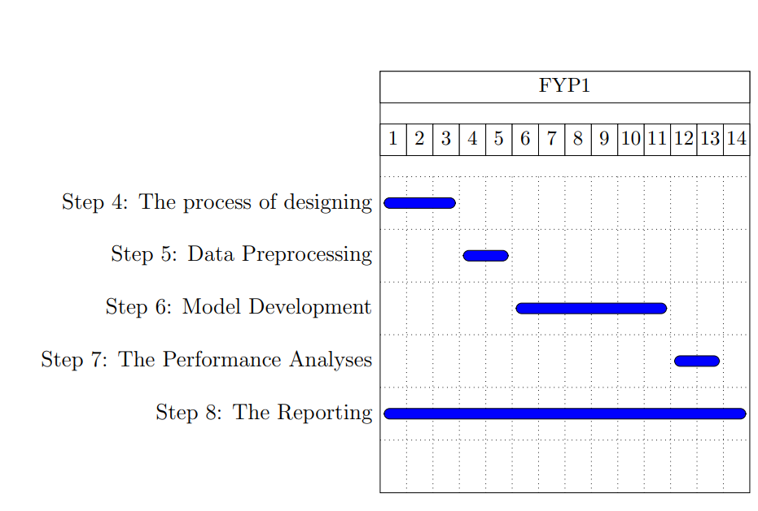
GANNT CHART

Slide 38
THANK YOU
PLEASE STATE YOUR VALUABLE COMMENTS AND QUESTIONS

